Slide 1
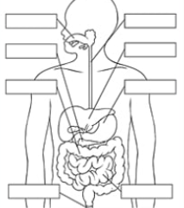
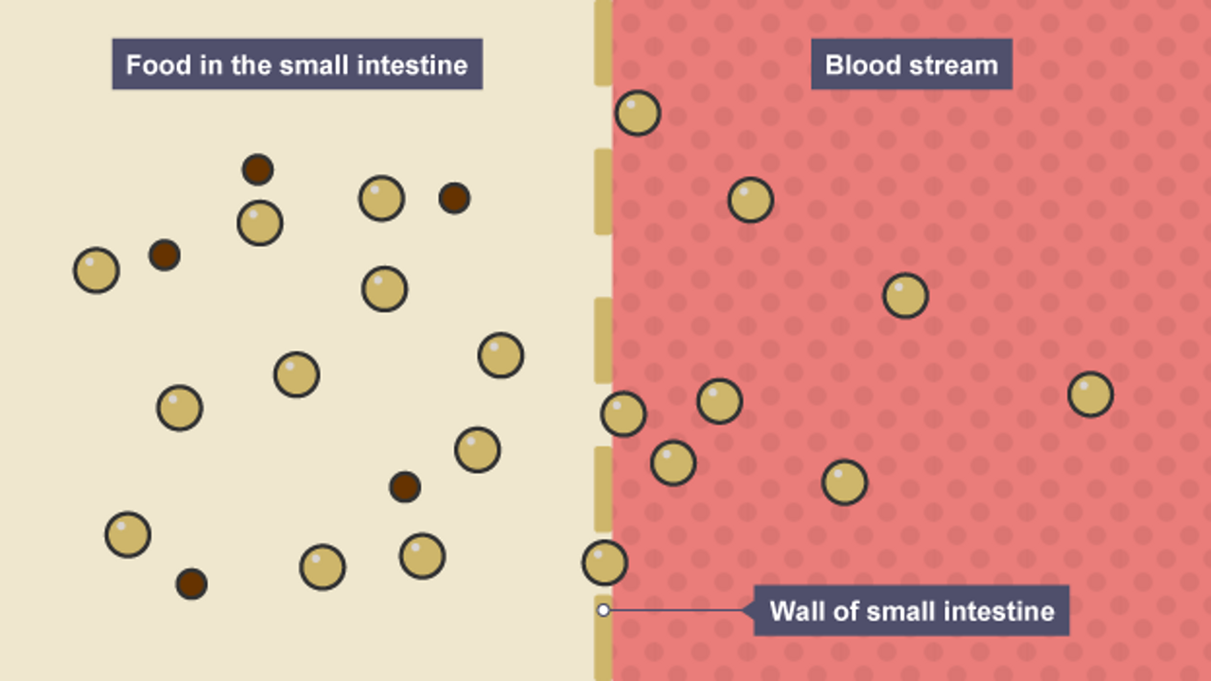
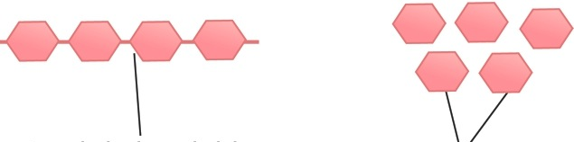

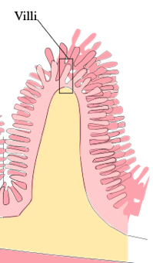


Knowledge Organiser
Year 8: Human Body - Digestion
Diagram showing the labelled parts of the human digestive system
What is starch?
Starch is a type of complex carbohydrate
If starch is broken down using an enzyme, the glucouse can be tested for using Benedict’s reagent
It will turn from blue -> brick red if glucouse is present
What are polymers?
Polymers are long and repeating chains of the same molecule stuck together
Starch is a long polymer of glucose molecules
Mouth
Oesophagus
What is digestion?
Digestion is the breaking down of food we eat into other substances
Our body cannot absorb or use food without breaking it down
It can mechanical or chemical
Pancreas
Liver
Large intestine
Stomach
Diagram which shows the movement of food molecules into the blood through digestion
Diagram showing the polymerisation of glucose to form starch
Absorption?
Without breaking them down, food molecules are too big to fit through holes in our small intestine
Anus
Small intestine
Starch polymer chain
Glucose molecules
Main biological molecules:
There are three main molecules we need to extract from the food we eat
They are carbohydrates, proteins and lipids (fats)
They are part of larger food molecules which we must break down to absorb and use
How is the small intestine adapted for absorption?
The small intestine is where most digested food is absorbed
The wall of the small intestine is covered with villi
These are tiny, finger-shaped structures that increase the surface area
They are only 1 cell thick, allowing for easy diffusion into the blood
Mechanical vs. chemical digestion?
Mechanical digestion involves physical movements
It includes chewing and muscle contractions
Chemical digestion uses enzymes to break down food
 | Uses in the body | Found in? | How to test for? | Positive test result?
Starch | Provides energy | Grains, rice, pasta, bread, potatoes | Add iodine | Yellow -> Black/Blue
Lipids | Store of energy, building cell membranes | Cheese, milk, butter, oils | Add Biuret reagent | Colourless → White emulsion
Proteins | Growth and repair of cells | Fish, meat, eggs, beans | Add ethanol and then water | Blue -> Purple
Diffusion into the blood?
Diffusion is the movement of particles from an area of high to low concentration
When we eat, food molecules (e.g. sugars) are at a high concentration in our small intestine
Our blood contains a low concentration of food molecules
So food molecules move by diffusion across the wall of the small intestine.
RAG Yourself!
Learning Outcomes; | RAG
Define diffusion and give examples of diffusion in the human body
State the main biological molecules and their uses
Describe how to test for starch and sugars
Label the digestive organs on a diagram
Explain the importance of digesting food
Explain the importance of villi in the intestines

Slide 2
Knowledge Organiser
Year 8: Human Body - Digestion
Diagram showing the labelled parts of the human digestive system
What is starch?
What are polymers?
What is digestion?
Diagram which shows the movement of food molecules into the blood through digestion
Diagram showing the polymerisation of glucose to form starch
Absorption?
Main biological molecules:
How is the small intestine adapted for absorption?
Mechanical vs. chemical digestion?
 | Uses in the body | Found in? | How to test for? | Positive test result?
Carbohydrates
Lipids
Proteins
Diffusion into the blood?
RAG Yourself!
Learning Outcomes; | RAG
Define diffusion and give examples of diffusion in the human body
State the main biological molecules and their uses
Describe how to test for starch and sugars
Label the digestive organs on a diagram
Explain the importance of digesting food
Explain the importance of villi in the intestines

